Slide 1

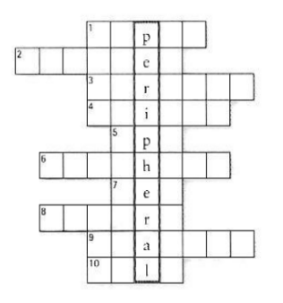
5.1 Solve the clues and complete the puzzle with words from A and B opposite.
1. Scanners and cameras are input devices used to transfer images into
a format that can be understood by computers.
2. A scanner you copy photos and printed documents into your PC.
3 It has become one of life's most familiar sounds – the beep of the
supermarket till whenever barcode scanned.
4. If you need to scan 35mm slides you should go for a dedicated
35mm film scanner which concentrates all its dots into a tiny area.
5. This scanner has a resolution of 300 x 600 dpi.
6. A digital scanner is small enough to hold in your hand
7. A handheld scanner is used to capture lines of text, barcodes and numbers.
8. A Most digital cameras use flash memory cards to store photos.
9. Flatbed scanners have a flat surface and take at least A4-sized documents.
10. To scan photographic negatives or slides you will need film scanner

Slide 2
5.2 Decide if these sentences are True or False. If they are false, correct them.
1 The details detected by a scanner are not determined by its resolution. (F)
2 A barcode scanner is a computer peripheral for reading barcode labels printed on products. (V)
3 Scanners cannot handle optical character recognition. (F)
4 A digital camera uses a light sensitive film instead of a memory card for storing the images. (F)
5 A digital video (DV) camera is used to take still photographs. (F)
6 Video editing software allows you to manipulate video clips on the computer. (V)
5.3. Complete this advertisement with words from the webcam section of C opposite
Having (1) video calls with friends and family has never been easier or more enjoyable. You get the highest-quality audio and video, no matter which chatting solution you use. With the WebCam Live! Ultra, its CCD image sensor with 640 x 480 (VGA) resolution produces rich, vibrant colours. Combined with its (2) USB 2.0 Hi-Speed connection, the result is top-quality, full-motion video at 30 (3) frames second for all your web conversations, even in dimly-lit rooms. The WebCam Live! Ultra lets you do more. Let your voice be heard clearer than ever before with the included (4)headset the built-in microphones in most other (5) earpiece Take still pictures at up to 1.3 (6) megapixels resolution (interpolated), and enjoy the many great features that accompany the bundled award-winning WebCam Center software, such as motion detection, remote security monitoring, timelapse video capture and much more.

